Slide 1
Principles of Programming Languages

Slide 2
Prerequisite: Data Structures & Algorithms and Object Oriented Programming
Course Objectives:
1 To Understand fundamental principles of programming language
2 To understand structural, computational and logical implications regarding programming languages
3 To explore main programming paradigms
4 To understand and apply Object Oriented Programming (OOP) principles using C++ and Java
Course Outcomes:
On completion of the course, student will be able to–
1 Write a survey on analysis of the strengths and weaknesses of programming languages for effective and efficient program development.
2 To inculcate the principles underlying the programming languages enabling to learn new programming languages.
3 To recognize and discuss different programming paradigms
4 To apply the programming paradigms effectively in application development followed by demonstration and a case study.

Slide 3
Introduction
Purpose of Studying this Subject
What should you expect to get out of this course
Study of Programming Language
Programming Language Concepts
What is programming language
Why Are There So Many Programming Languages
Types of programming languages.
Why Study programming language
A short history of programming language
Influences on programming language
Attributes of good language.

Slide 4
Purpose of Studying PPL
The purpose of the course is for the student to gain knowledge of important principles in programming languages
and for the student to gain an understanding of techniques for describing and compiling programming languages.

Slide 5
What should you expect to get out of this course
Ideas, principles and techniques to help you
Design your own programming language or design your own extensions to an existing language
Lots of knowledge about programming languages
Tools and techniques to implement a compiler or an interpreter

Slide 6
Programming Language Concepts
What is a programming language?
Why are there so many programming languages?
What are the types of programming languages?
Does the world need new languages?

Slide 7
What is a Programming Languages
A programming language is a set of rules that provides a way of telling a computer what operations to perform.
A programming language is a set of rules for communicating an algorithm
It provides a linguistic framework for describing computations

Slide 8
What is a Programming Language
English is a natural language. It has words, symbols and grammatical rules.
A programming language also has words, symbols and rules of grammar.
The grammatical rules are called syntax.
Each programming language has a different set of syntax rules.

Slide 9
Definition of Programming language
A language that is intended for the expression of computer programs and that is capable of expressing any computer program.

Slide 10
Why There Are So Many Programming Languages
Programming languages have evolved over time as better ways have been developed to design them.
First programming languages were developed in the 1950s
Since then thousands of languages have been developed
Different programming languages are designed for different types of programs.
Productivity, Performance and Generality.

Slide 11
Levels of Programming Languages
High-level program
class Triangle {
...
float surface()
return b*h/2;
}
Low-level program
LOAD r1,b
LOAD r2,h
MUL r1,r2
DIV r1,#2
RET
Executable Machine code
0001001001000101001001001110110010101101001...

Slide 12
Does the world need new Languages??

Slide 13
Why study programming languages?
Programming languages are important for students in all disciplines of computer science because they are the primary tools of the central activity of computer science programming.
There is an idea: the structure of language defines the boundaries of thought.
Increased capacity to express ideas
Improved background for choosing appropriate languages
Increased ability to learn new languages
Better understanding of the significance of implementation
Increased ability to design new languages
Background for compiler writing

Slide 14
To improve your ability to develop effective algorithms and to improve your use of your existing programming language.
O-O features, recursion
Call by value, call by reference
To increase your vocabulary of useful programming constructs.
To allow a better choice of programming languages.

Slide 15
A short history of programming Languages
1950 : LISP, FORTRAN
1970 : Ada, C, Pascal, Prolog, Smalltalk
1980 : C++
During 1970 : a lot of PLs were designed.
Early languages:
Numerically based languages. (FORTRAN:55,ALGOL:58)
Business languages. (COBOL:60)
Artificial intelligence languages. (LISP,Prolog)
Systems languages. ( C:70)

Slide 16
A short history of programming languages (cont.)
80s:
Development of functional programming: ML, Miranda
Need for reliability and maintainability: Ada
Object-oriented programming: Smalltalk, C++
90s:
Fourth-generation languages
Productivity tools (such as spreadsheets)
Visual languages : Delphi
Scripting languages : Perl
Expert systems shells
Network computing : Java

Slide 17
Unit 1
Programming Language Syntax and Semantics

Slide 18
Contents
Software development process
Languages and software development environments Languages and software design methods Languages and computer architecture.
Programming language qualities
Languages and reliability
Languages and maintainability Languages and efficiency
A brief historical perspective
A bird’s eye view of programming language

Slide 19
Software Development Process
Splits the software development work into different phases containing activities for the purpose of better planning and management.
SDLC method are :
Waterfall model
Prototyping model
Iterative model
Incremental development
Rapid application development model
Spiral development and many other types of
Agile methodology.
Software Development process designs, develops and tests high quality software. The goal of this process is to fulfil the customer requirements, provide better quality software and on time delivery of product.
Software organizations use this SDLC process for completion and execution of process. It consists of detailed planning that how to develop software, how to maintain, and what up gradation will be required

Slide 20
SDLC Models
Waterfall Model Design
Waterfall approach was first SDLC Model to be used widely in Software Engineering to ensure success of the project.
As the name is “The Waterfall”, in this approach, the whole software development process is divided into different phases.
In Waterfall model, normally, the output of first phase is given as input to the second phase and so on.
This means execution takes place in sequential manner.

Slide 21
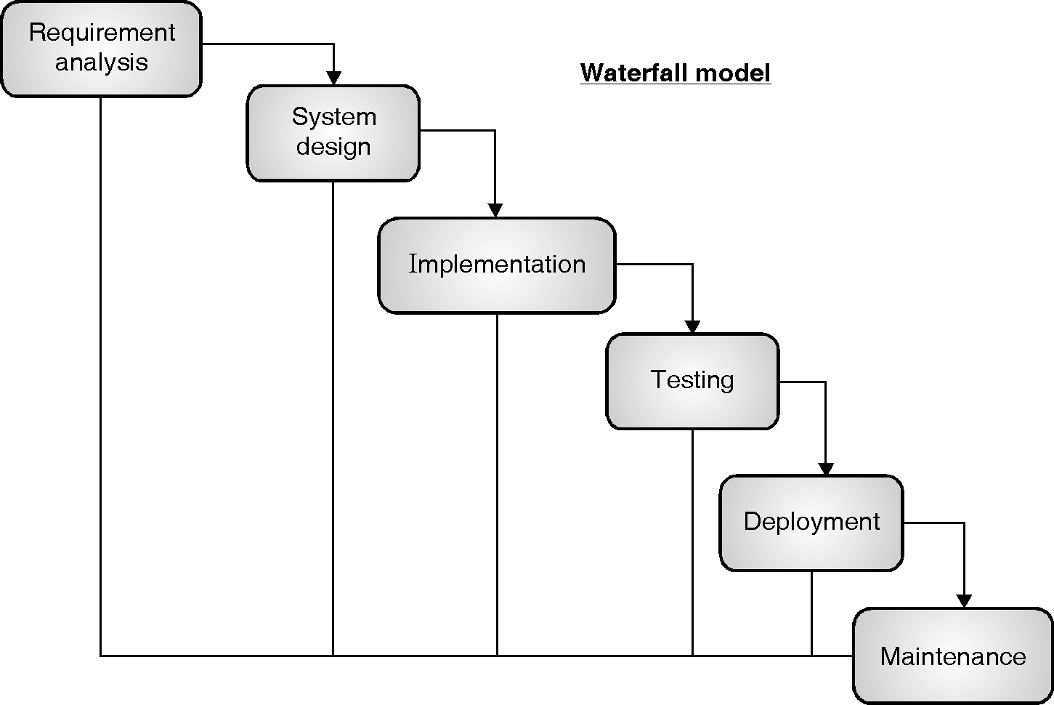

Slide 22
Waterfall Model
Requirement Gathering and analysis : In this phase, all the requirements are gathered from the sources and they are documented in requirement specific document.
System Design : In this phase, the requirement specifications from first phase are studied and system design is prepared. This System Design helps to identify hardware required and overall system architecture is also defined.
Implementation : The system first develops small modules or programs using the input from system design, these small modules are called as units. In next phase, the units are integrated. Each developed unit is then tested for its functionality which is referred as Unit Testing.

Slide 23
Waterfall Model cont..
Integration and Testing : The small units developed and tested in implementation phase are integrated into system. Again the integrated unit is tested for faults and failures.
Deployment of system : Once the functional and non functional testing is done, the product is deployed in the customer environment or released into the market.
Maintenance : After the product is deployed, chances are that some problems may arise at client side environment. In order to fix those issues maintenance phase is required which releases patches. Also to enhance the product some better versions are released. To deliver these changes to client maintenance is done.

Slide 24
Advantages :
Simple and easy
Easily manageable , each phase has specific deliverables.
One phase at a time
Smaller projects.
Disadvantages:
Difficult to go back and change in previous phase.
High risk and uncertainty.
Not good idea for large and complex projects.
When to use:
This model is used when requirements are fixed and not ambiguous for short projects.

Slide 25
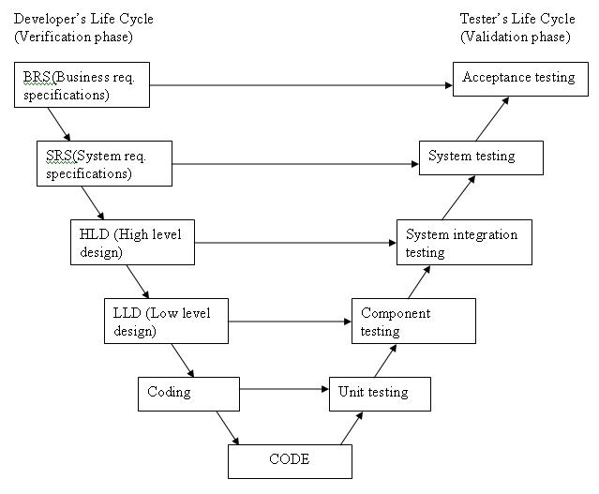
A variation in the representation of waterfall model is called the V – model.

Slide 26
The high-level design (HLD): system architecture and design. It provide overview of solution, platform, system, product and service/process.
An integration test plan is created in this phase as well in order to test the pieces of the software systems ability to work together.
The low-level design (LLD) phase is where the actual software components are designed. It defines the actual logic for each and every component of the system. Class diagram with all the methods and relation between classes comes under LLD. Component tests are created in this phase as well.
Advantages of V-model:
Simple and easy to use.
Testing activities like planning, test designing happens well before coding. This saves a lot of time. Hence higher chance of success over the waterfall model.
Proactive defect tracking – that is defects are found at early stage.
Avoids the downward flow of the defects.
Works well for small projects where requirements are easily understood.

Slide 27
Disadvantages of V-model:
Very rigid and least flexible.
Software is developed during the implementation phase, so no early prototypes of the software are produced.
If any changes happen in midway, then the test documents along with requirement documents has to be updated.
When to use the V-model:
The V-shaped model should be used for small to medium sized projects where requirements are clearly defined and fixed.
The V-Shaped model should be chosen when ample technical resources are available with needed technical expertise.

Slide 28
PLs as Components of a Software Development Environment
Goal: software productivity
Need: support for all phases of SD
Computer-aided tools (“Software Tools”)
Text and program editors, compilers, linkers, libraries, formatters, pre-processors
E.g., Unix (shell, pipe, redirection)
Software development environments
E.g., Interlisp, Jbuilder
Intermediate approach:
Emacs (customizable editor to lightweight SDE)

Slide 29
Languages and Software Development Environments
Environment refers to the group of hardware and software tools used by a system developer to build software.
Coding is the mainly supported with tools such as compilers, linkers, text editors and libraries.
Though both software development environment and programming environment are considered as a same, in this context, there is difference between these two phrases.
“Programming environment” is the atmosphere that supports coding phase of SDL cycle. It only facilitates the small tasks like editing, compiling etc.
“Software development environment” supports various activities of SDL cycle like configuration management, project management, team management.

Slide 30
Pl’s and Software Design Methodology
A methodology can be defined as the basic ethics and rules that govern a system.
Software designers are guided by different design methodology
Eg: for decomposing a system into modules, procedural design methods are used.
Object oriented methods decomposes a system into classes and object.
Different methodologies support works in different phases of the system life cycle, for example, planning, analysis, design and programming, testing and implementation.

Slide 31
Some design methods are better supported by some programming languages.
Some of the older languages are not well-suited for particular design methods.
For example : a method which requires every task to be accomplished using objects, can use c++ or java.
and top down method can use pascal or c.
Most of the time programming languages impose particular programming style.
These styles are called as programming paradigms.
These paradigms impacts the relationship between design method and programming languages.
We can classify programming languages as per the computer programming style with the help of programming paradigm notion.

Slide 32
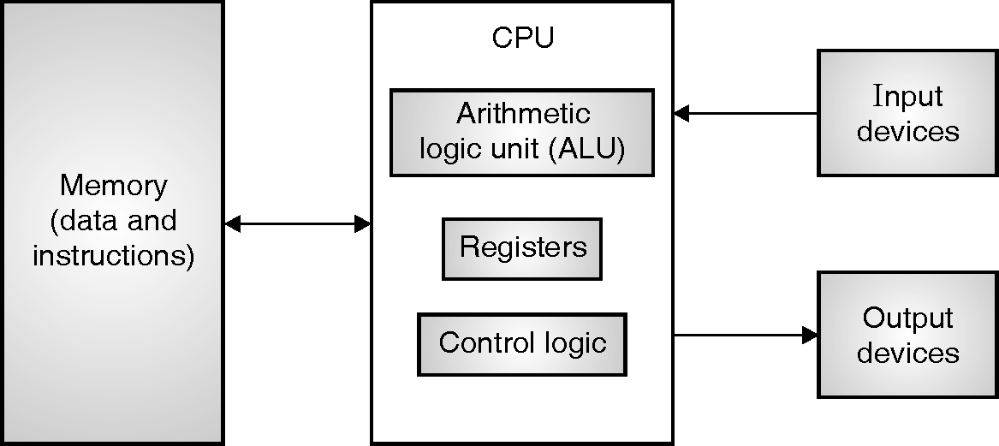
Computer Architecture and PLs
The Von Neumann architecture, given in figure 2, is in accordance with the idea of a CPU, an I/O unit and memory to store data, instructions.

Slide 33
Conventional languages based on the Von Neumann computation model are often called imperative languages. The historical developments of imperative languages have gone through increasingly higher levels of abstractions.
Few languages like, Functional and logical languages have discarded the Von Neumann computation model. Both paradigms follow the mathematical foundations instead of hardware technology: the theory of recursive functions and mathematical logic.
The different underlying computation model of the language is reflected by imperative, functional and logic paradigms. Different organizational principles for program structuring are reflected by next level paradigms which are supported by the language.

Slide 34
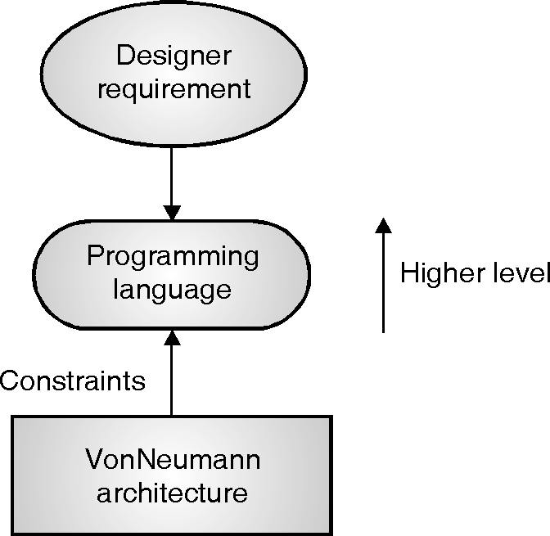

Slide 35
Other Computer Architectures
Harvard
separate data and program memories
Functional architectures
Symbolics, Lambda machine, Mago’s reduction machine
Logic architectures
Fifth generation computer project (1982-1992) and the PIM
Overall, alternate computer architectures have failed commercially
von Neumann machines get faster too quickly!

Slide 36
Influences on programming languages
Computer capabilities
Hardware and OS
Applications
Wide area of applications (open mp,cuda,scala..)
Programming methods
Multiprogramming, interactive systems, data abstraction, formal semantics,O-O programming,…
Implementation methods
Theoretical studies
Standardization

Slide 37
Attributes of a good language
Clarity, simplicity, and unity
Have a minimum number of different concepts, with the rules for their combination, simple and regular (conceptual integrity).
readability
Orthogonality
Being able to combine various features of a language in all possible combinations.
Naturalness for the application
Support for abstraction

Slide 38
Attributes of a good language
Ease of program verification
Proof of correctness, desk checking, test
Simplicity of semantic and syntax
Programming environment
Portability of programs
Cost of use
Program execution
Program translation
Program creation, testing, and use
Program maintenance

Slide 39
Programming language qualities
Software must be reliable.
Software must be maintainable.
Software must execute efficiently

Slide 40
Attributes of a good language (another view: to make a software reliable, maintainable, efficient)
Reliability
Writability
Readability
Simplicity
Safety (no goto, no pointers)
Robustness (undesired events can be trapped, like arithmetic overflow, invalid inputs)
Maintainability
Factoring (modularity, appropriate names for constants)
Locality
Efficiency (Execution Speed, Space, Reusable, Portable)

Slide 41
Languages and reliability
Writability
Readability
Simplicity
Safety
Robustness

Slide 42
Languages and maintainability
Easily modifiable.
Readability and simplicity are obviously important in this context
Two main features:
Factoring:
This means that the language should allow programmers to factor related features into one single point
In doing so, the program becomes more readable and more easily modifiable.
As another example, several programming languages allow constants to be given symbolic names. Choosing
an appropriate name for a constant promotes readability of the
program (e.g., we may use pi instead of 3.14).

Slide 43
Locality:
This means that the effect of a language feature is restricted to a small, local portion of the entire program. Otherwise, if it extends to most of the program, the task of making the change can be exceedingly complex.

Slide 44
Languages and Efficiency
Efficiency can be achieved by:
More execution speed
Less memory consumption
Efficiency is no longer measured only by the execution speed and space. The effort required to produce a program or system initially and the effort required in maintenance can also be viewed as components of the efficiency measure.
Reusability
Portability

Slide 45
What makes a successful language?
The following key characteristics:
Simplicity and readability
Clarity about binding
Reliability
Abstraction
Orthogonality
Efficient implementation
Notes:
[T]

Slide 46
Simplicity and Readability
Small instruction set
E.g., Java vs Scheme
Simple syntax
E.g., C/C++/Java vs Python
Benefits:
Ease of learning
Ease of programming
Notes:
[T]

Slide 47
Clarity about Binding
A language element is bound to a property at the time that property is defined for it.
So a binding is the association between an object and a property of that object
Examples:
a variable and its type
a variable and its value
Early binding takes place at compile-time
Late binding takes place at run time
Notes:
[T]

Slide 48
Reliability
A language is reliable if:
Program behavior is the same on different platforms
E.g., early versions of Fortran
Type errors are detected
E.g., C vs Haskell
Semantic errors are properly trapped
E.g., C vs C++
Memory leaks are prevented
E.g., C vs Java
Notes:
[T]

Slide 49
Abstraction in Programming
Data
Programmer-defined types/classes
Class libraries
Procedural
Programmer-defined functions
Standard function libraries
Notes:
[T]

Slide 50
Orthogonality
Defining: orthogonality in a programming language means that a relatively small set of primitive constructs can be combined in a relatively small number of ways to build the control and data structures of the language
It is associated with simplicity; the more orthogonal the design, the fewer exceptions.
In programming languages this means that when you execute an instruction, nothing but that instruction happens (very important for debugging).
Notes:
[T]

Slide 51
Efficient implementation
Embedded systems
Real-time responsiveness (e.g., navigation)
Failures of early Ada implementations
Web applications
Responsiveness to users (e.g., Google search)
Corporate database applications
Efficient search and updating
AI applications
Modeling human behaviors
Notes:
[T]

Slide 52
A bird’s eye view of programming language concepts
Using a simple C/C++ program as an example, we look at the kinds of facilities that a programming language must support and the different ways that languages go about providing these facilities.
Simple Program
Syntax & Semantics
Semantic elements
Program Organization
Program data and algorithm
Looking to the program, we want to look at not what it does, but what kinds of linguistic facilities were used to write the program.

Slide 53
Bird eye view of PL concepts
The line extern phone_list pb; indicates that the variable pb of type phone_list is being used in this program
The third part, It contains the program’s data and algorithms
the routines insert and lookup are used in the main program
the output statement: cout << “Enter 1 to insert, 2 to lookup: \n”;which uses cout, the standard output device defined in the standard input-output library iostream.h included in the first line of the program.

Slide 54
The syntax rules of the language state how to form expressions, statements, and programs that look right
The semantic rules of the language tell us how to build meaningful expressions, statements, and programs
the declaration of a variable such as request causes storage to be reserved for the variable.
the presence of the extern in the declaration of the variable pb indicates that the storage is reserved by some other module and not this one

Slide 55
#include <iostream.h>
#include “phone.h”
extern phone_list pb;
void insert();
number lookup ();
main()
{
int request;
cout << “Enter 1 to insert, 2 to lookup: \n”;
cin >> request;
if (request == 1)
insert();
else if (request == 2)
cout << lookup();
else
{cout << “invalid request.\n”;
exit (1);
}
}
is used to organize the structure of the program
Environment
consists of three “declaration” statements
Computation
the actual code of a function

Slide 56
Syntax and semantics
Syntax explains the structure of programs and semantics describes the relationship between the syntax and the computational model.
The syntax of programming language is closely related to the computational model, in order to simplify the task of reasoning about programs. The key principle is the principle of clarity.

Slide 57
Semantic elements
Variables
1. A Name 2. A Type
3. A Value 4. A Scope
A Life Time

Slide 58
Semantic elements
Variables
A variable corresponds to a region of memory which is used to hold
values that are manipulated by the program.
semantic properties of variables are
Scope which part of the program has access to the variable?
Type what kinds of values may be stored in the variable and what operations may be performed on the variable?
Lifetime when is the variable created and when is it discarded?
static variables live throughout the execution of the program
Values and references
An assignment statement of the form:
x = y;
The value referred to by the name y is of a different kind from that referred to by the name x.

Slide 59
right hand side of this assignment statement, we need the contents of that memory
left hand side we need the address of, or a reference to, that region
an l-value is a value that refers to a memory location
an r-value is a value that refers to the contents of a memory location
x = &y; stores the address of y into x.
3 = y; //error, left-hand side requires l-value
is an error because literals in C++ do not have l-values.
Instead, y = 3;

Slide 60
Expressions
Expressions are syntactic constructs that allow the programmer to combine values and operations to compute new values
ex: request == 1, is an expression of type boolean
“invalid request.\n” is an expression of type string
the order in which operations are performed in an expression may influence the value of the expression
Consider: a = b = c + d;
P = a=b=c=c+d/c
Program organization
a file called iostream.h, which provides the declarations to use the standard inputoutput library provided by C/C++.

Slide 61
The other file included by the program is called phone.h. This file is presumably more specific to this application and contains information, such as type definitions, that are shared by different modules of the program
Program data and algorithms
the main program consists of some variable declarations and some statements that operate on these variables.
The execution of statements modifies the values stored in the memory of the underlying machine; i.e., it modifies the state of the computation

Slide 63
Syntax and Semantics
Language Definition
Syntax :
Semantics :
Pragmatics:
It hints at characteristics of language, which are related to language users;
e.g. utility or scope of application, its effect on user etc.
For programming languages, it includes points such as implementation ease, efficient application and programming methodology.

Slide 64
Syntax
The syntax does not inform us anything regarding the substance (or significance) of the sentence– the semantic guidelines let us know that.
For instance, C , (for example, while, do, if, else,...), identifiers, numbers, operators, ... are words of the language. The C syntax lets us know how to join such words to develop all around shaped statements and programs.
The language syntax is characterized by two arrangements of rules: lexical and syntactic rules.
Lexical principles determine the arrangement of characters that constitute the alphabets of language and the way such characters can be joined to shape legitimate words.

Slide 65
Syntax and Semantics
Syntax
form or structure of expressions or statements for a given language
For instance, in Java, the form of a while loop is
while(<bool_expr) <stmt>
Semantics
meaning of the expressions
Language
group of words that can be combined and the rules for combining those words
Sentence
a legal statement in the language
Lexeme
lowest level syntactic unit in the language
Token
a language category for the lexemes
Example (in Java):
index = 2 * count + 17;
Lexeme: Token:
index identifier
= assignment_operator
2 integer_literal
* mult_operator
count identifier
+ addition_operator
17 integer_literal
; semicolon
Notes:
We study syntax to better understand:
the components of a language and their roles
how to define a language
how to recognize whether a statement is legal with respect to a language
we will use this to build language recognizers (parsers/compilers)
We study semantics to better understand:
the meaning behind a statement
specifically, we will use semantic techniques to verify if a program does what we think it should
Semantics is often studied at the graduate level. Since this class combines graduate and undergraduate students, we will spend a little time studying semantic techniques, but not a great deal of time. Graduate students will be asked to explore semantics in greater detail on their assignments.
Our study of syntax will revolve around the grammar, a way to express a language. The grammar uses notation like this:
S → A | B | aA | bB | a | b
The capital letters are categories, or non-terminals, the lower case letters are terminals. In this grammar, starting at S, you can generate one or more a’s or one or more b’s

Slide 66
Languages
Language Recognizer
given a sentence, is it in the given language?
Language Generator
given a language, create legal and meaningful sentences
We can build a language recognizer if we already have a language generator
Grammar
a description of a language - can be used for generation or, given the grammar, a language recognizer (known as a parser) can be created
We classify languages into one of four categories:
Regular
Context-Free
Context-Sensitive
Recursively Enumerable
Here, we are interested in the context-free grammar
these include those which can be generated from a language generator
all natural languages and programming languages fall into this category
Notes:
Regular (type-3) languages restrict the grammar rules so that there can be no ambiguity from a statement generated. Specifically, a rule consists of a single nonterminal on the left-hand side and a right-hand side consisting of a single terminal, possibly followed by a single nonterminal. An expression generated from a regular grammar can always be recognized by a finite state automata. A regular expression (as you might define in Perl or with the grep utility in Linux) is from a regular language.
Context-free (type-2) languages are defined by rules that consist of a single nonterminal on the left-hand side and a combination of non-terminals and terminals on the right-hand side. An expression generated from a context-free grammar can always be recognized by a push-down automata (a finite-state automata combined with a stack). The idea is that to completely recognize a statement, context (what is pushed on the stack) may be required. The syntax of programming languages fall into this category.
Context-sensitive (type-1) languages have rules with left-hand and right-hand sides that can both contain non-terminals and terminals as long as the size (number) of left-hand symbols <= those on the right-hand side. Statements generated in such a language can be recognized by a non-deterministic Turing machine with a finite sized tape. To parse and compile a program in a programming language (context-free language), you must have at least a context-sensitive language parser because the context-free parser does not contain such capabilities as determining type mismatch or duplicate identifier names or incorrect number of parameters in a formal parameter list.
Recursively enumerable (type-0, also known as unrestricted) languages include all grammars (including those above) but are extended to any other language whose statements can be recognized by a Turing machine (with no restrictions). A computer is a Turing machine. This level of grammar places no restriction on the size of either side.
The above classification allows us to know whether a given language/grammar can be used for search expressions, for programming languages, or to define problems that may or may not be solvable. In this course, we will limit our study of languages and grammars to type-2.

Slide 67
Language Definition
A language definition should enable a person or a computer program to determine (1) whether a supposed program is infact valid, and (2) if the program is valid, what its meaning or effect is
Syntax
syntax of a language is defined by two sets of rules: lexical rules and syntactic rules.
Lexical rules specify the set of characters that constitute the alphabet of the language and the way such characters can be combined to form valid words.
Ex: Pascal considers lowercase and uppercase characters to be identical
Memory” and “memory” refer to the same variable in Pascal
C and Ada consider them to be distinct

Slide 68
<> (or ¦) is a valid operator in Pascal
Ada differs from both, since “not equal” is represented as /=; delimiter <> (called “box”) stands for an undefined range of an array index.
distinction between syntactic and lexical rules, both contribute to the “external” appearance of the language
EBNF [Extended Backus Naur form ]is a meta-language
A meta-language is a language that is used to describe other languages
The symbols ::=, <, >, *, +, (, ), and | are symbols of the metalanguage: they are metasymbols.
A language is described in EBNF through a set of rules. For example, <program> ::= { <statement>* } is a rule
.

Slide 69
"::=" stands for “is defined as”
symbol “*” stands for “an arbitrary sequence of the previous element”
a <program> is defined as an arbitrary sequence of <statement> within brackets “{” and “}”.
The entities inside the metalanguage brackets “<”, and “>” are called nonterminals; an entity such as the “}” above is called a terminal
Terminals are what we have previously called words of the language being defined
nonterminals are linguistic entities that are defined by other EBNF rules

Slide 70
Distinguish between metasymbols and terminals
EBNF, the metasymbol “+” denotes one or more repetitions of the previous element (i.e., at least one element must be present, as opposed to “*”).
metasymbol “|” denotes a choice
(a) Syntax rules
<program>::={ <statement>* }
<statement>::=<assignment> | <conditional> | <loop>
<assignment>::=<identifier> = <expr> ;
<conditional>::=if <expr> { <statement> + } |
if <expr> { <statement> + } else { <statement> + }
<loop>::=while <expr> { <statement> + }
<expr> ::=<identifier> | <number> | ( <expr> ) |
<expr> <operator> <expr>

Slide 71
(a) Syntax rules
<program>::={ <statement>* }
<statement>::=<assignment> | <conditional> | <loop> <assignment>::=<identifier> = <expr> ;
<conditional>::=if <expr> { <statement> + } |
if <expr> { <statement> + } else { <statement> + }
<loop>::=while <expr> { <statement> + }
<expr> ::=<identifier> | <number> | ( <expr> ) | <expr> <operator> <expr>

Slide 72
(b) Lexical rules
<operator>::= + | - | * | / | = | ¦ | < | > | ≤ | ≥
<identifier>::= <letter> <ld>*
<ld>::= <letter> | <digit>
<number>::= <digit>+
<letter>::= a | b | c | . . . | z
<digit>::= 0 | 1 |2 | . . . | 9

Slide 73
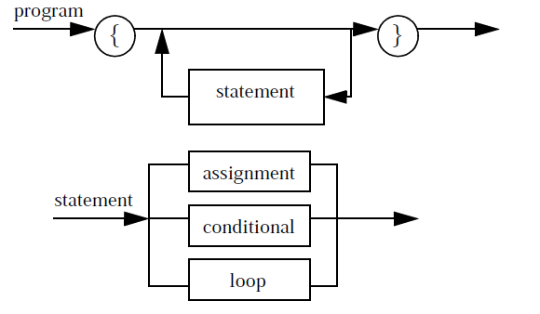
Syntax diagrams are similar enough to EBNF to allow you to understand the rules.

Slide 74
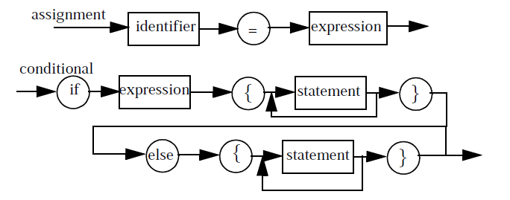

Slide 75
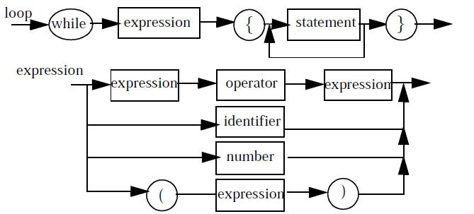

Slide 76
Nonterminals are represented by boxes and terminals by circles
Transition diagram having one entry and one exit edge i.e. nonterminal symbol
if a terminal (circles) is encountered, that word must be in the string being recognized
if a nonterminal (box) is encountered, then that nonterminal must be recognized by traversing the transition diagram for that nonterminal.

Slide 77
Syntactic description of a language has two primary uses
(a) It helps the programmer know how to write a syntactically correct program. For eg: if statement
(b) It can be used to determine whether a program is syntactically correct
compiler writer uses the grammar to write a syntactic analyzer (also called parser) that is capable of recognizing all valid programs
LEX and YACC are two wellknown UNIX tools that generate lexical and syntax analyzers, respectively

Slide 78
Abstract syntax, concrete syntax and pragmatics
Programming languages have the same conceptual structure but differ in their appearance
C fragment Pascal fragment
while (x != y) while x <> y do
{ . . . }; begin . . . End
When two constructs differ only at the lexical level, we say that they follow the same abstract syntax, but differ at the concrete syntax level
they have the same abstract structure and differ only in lower-level details
Modula-2 adopts a good concrete syntax solution, by using the “end” keyword to terminate both loop and conditional statements

Slide 79
if x = y then if x = y then while x = y do
. . . end . . . . . .
else end
. . .
end
Concrete Syntax:
Set of production rules to represent program,
The way program Looks like to the programmer.
Abstract Syntax:
Set of trees used to represent program
The way program looks like to the Compiler.
.
+
*
4
2
3

Slide 80
Parse Trees
A hierarchical structure displaying the derivation of an expression in some grammar
Leaf nodes are terminals, non-leaf nodes are non-terminals
Parser
Process which takes a sentence and breaks it into its component parts, deriving a parse tree
If the parser cannot generate a parse tree, then the sentence is not legal
If the parser can generate two or more parse trees for the same sentence, then the grammar is ambiguous
Notes:
You might recall parse trees from your grammar school days when you were learning English grammar. Here’s a very simple example of a parse tree in English.
Here’s an example of an assignment
statement broken down as a parse tree.
Notice that each node has the lexeme and
its associated (recognized or identified) token.

Slide 81
Grammar and Parse Tree
<assign> → <id> = <expr>
<id> → A | B | C
<expr> → <id> + <expr>
| <id> * <expr>
| (<expr>)
| <id>
<assign>
<id> = <expr>
A <id> * <expr>
B ( <expr> )
<id> + <expr>
A <id>
C
Parse tree for the derivation
<assign> → <id> = <expr> → A = <expr>
→ A = <id> * <expr> → A = B * <expr>
→ A = B * (<expr>) → A = B * (<id> + <expr>)
→ A = B * (A + <expr>) → A = B * (A + <id> )
→ A = B * (A + C)
Notes:
Above we see how the derivation is used to create the parse tree. Each step of the derivation provides a new level (depth) in the tree. The highest level starts with <assign>. We now match the rule <assign> → <id> = <expr> and so the next level of the parse tree as <id> = <expr>. Next, we use the rule <id> → A. The next rule is <expr> → <id> * <expr>. We place A (on the left side of the tree) and <id> * <expr> (on the right side of the tree) at the same level because the two rules were applied independently.
As we will see, the level that a rule was applied will have an implication on the order of precedence in terms of when the operation is physically performed by the computer. Above, we apply + first (after getting the values of A & C), then *, and finally =.

Slide 82
An Ambiguous Grammar
<assign> → <id> := <expr>
<id> → A | B | C
<expr> → <expr> + <expr> | <expr> * <expr> | (<expr>) | <id>
With this grammar, the sentence
<assign> → A = B + A * C
has two distinct parse trees
see next slide
The reason this is important is that the second parse tree represents an interpretation of the expression where + has higher precedence than * which would give us an incorrect answer
Notes:
We need to ensure that * has a higher precedence than + so that the meaning of the above statement is really A = B + (A * C). Our grammar is ambiguous however, so that in fact the previous statement could possible be interpreted as A = (B + A) * C if we perform leftmost derivations. We see this on the next slide.

Slide 83
Two Parse Trees for A = B + A * C
<assign>
<id> = <expr>
A <expr> + <expr>
<id> <expr> * <expr>
B <id> <id>
A C
<assign>
<id> = <expr>
A <expr> * <expr>
<expr> + <expr> <id>
<id> <id> C
B A
The lower down the operator in the parse tree, the higher its precedence
so on the left, * has a higher precedence than + (which is as it should be)
but the tree on the right is incorrect, essentially being A = (B + A) * C even
though there are no parentheses specified to alter the precedence

Slide 84
An Unambiguous Grammar
<assign> → <id> := <expr>
<id> → A | B | C
<expr> → <expr> + <term> | <term>
<term> → <term> * <factor> | <factor>
<factor> → (<expr>) | <id>
Here, we force operator
precedence by making a
multiplication occur lower
in the tree by deriving it
through an additional rule
( ) having the highest
precedence requires the
most derivation to get to it
Notes:
Why is this unambiguous? In order to apply *, we have to convert our <expr> into a <term> since <term> is the level for an *. So if we have a statement like A + B * C, then we must apply the rule <expr> → <expr> + <term> and follow this with <term> → <term> * <factor>. Since the rule with + is earlier in our derivation, it is higher in the tree, and thus has a lower order of operator precedence.
Can we still generate A + B * C where + occurs first when executing the code? Yes, as follows:
<expr> → <term>
<term> → <term> * <factor>
<factor> → (<expr>)
<expr> → <expr> + <term>
So what we wind up with is C * (A + B). With associativity, this is equivalent to (A + B) * C. In order to have + have higher precedence, it can only be achieved when we place that subexpression in ( ) to give + a higher precedence than *.
Now that we have made our grammar unambiguous, what would we do if we wanted to add ** (exponent) to our grammar? It should have higher precedence than * but lower precedence than ( ).

Slide 85
Derivation and Parse Tree
of the Unambiguous Grammar
<assign>
<id> = <expr>
A <expr> + <term>
<term> <term> * <factor>
<factor> <factor> <id>
<id> <id> A
B C
<assign> → <id> = <expr>
→ A = <expr>
→ A = <expr> + <term>
→ A = <term> + <term>
→ A = <factor> + <term>
→ A = <id> + <term>
→ A = B + <term>
→ A = B + <term> * <factor>
→ A = B + <factor> * <factor>
→ A = B + <id> * <factor>
→ A = B + C * <factor>
→ A = B + C * <id>
→ A = B + C * A
Notes:
Try to generate A = (B + C) * A instead.

Slide 86
Semantics
Semantics is all about understanding of programs and prediction of its outcome. The mapping of Syntactical constructs to computational model is mainly done in semantics.
semantics : syntax --> computational model
This approach is called syntax-directed semantics.
If the meaning of syntactically correct program is verified before the program execution then it is called static semantic
If the meaning of syntactically correct program is verified after the program execution then it is called dynamic semantic
There are many ways a program can be written with valid syntax but turn nonsensical when evaluated. These nonsensical evaluations are known as runtime errors.
Semantics formally describes how programs should be evaluated. Programs that are well-formed according to its semantics do not get stuck.

Slide 87
There are several techniques such as (algebraic, axiomatic, denotational, operational, and translation) are used for description of the semantics of programming languages.
Algebraic semantics describes the meaning of a program by defining an algebra. The axioms and equations are described by algebraic relationships and operations.
An algebra consists of a domain of values and a set of operations (functions) defined on the domain.

Slide 88
Algebraic definition of an Integer Stack ADT
Domains: Nat (the natural numbers Stack ( of natural numbers) Bool (boolean values) Functions: newStack: () -> Stack push : (Nat, Stack) -> Stack pop: Stack -> Stack top: Stack -> Nat empty : Stack -> Bool Axioms: or pop(push(N,S)) = S top(push(N,S)) = N empty(push(N,S)) = false empty(newStack()) = true Errors: pop(newStack()) top(newStack()) where N in Nat and S in Stack. | Defining Equations: newStack() = [] push(N,S) = [N|S] pop([N|S]) = S top([N|S]) = N

Slide 89
Axiomatic Semantics
A semantics that is appropriate for arguing program correctness

Slide 90
Axiomatic Semantics
Is an approach based on mathematical logic to prove the correctness of the program. That means under certain constraints on input data (precondition) program executes and it terminates in a final state satisfying constraint on output data
Axiomatic semantics views a program as a state machine
Based on formal logic (predicate calculus)
Original purpose: formal program verification
Axioms or inference rules are defined for each statement type in the language
The logic expressions are called assertions

Slide 91
An assertion before a statement (a precondition) states the relationships and constraints among variables that are true at that point in execution
An assertion following a statement is a postcondition
A weakest precondition is the least restrictive precondition that will guarantee the postcondition.
Pre-, post form: {P} statement {Q}
An example
a = b + 1 {a > 1}
One possible precondition: {b > 10}
Weakest precondition: {b > 0}

Slide 92
Example 1: {k=5} k:=k+1{k=6}
K=6 post condition
K+1=6 (substituting k=6)
Precondition satisfies.
Example 2: {j=3, k=4} j:=j+k {j=7,k=4}

Slide 93
One-Slide Summary
• An axiomatic semantics consists of: – A language for stating assertions about programs, – Rules for establishing the truth of assertions
• Some typical kinds of assertions: – This program terminates
– If this program terminates, the variables x and y have the same value throughout the execution of the program
– The array accesses are within the array bounds
• Some typical languages of assertions – First-order logic – Other logics (temporal, linear, pointer-assertion) – Special-purpose specification languages (SLIC, Z, Larch)

Slide 94
Other Applications of Axiomatic Semantics
• The project of defining and proving everything formally has not succeeded (at least not yet)
• Proving has not replaced testing and debugging
• Applications of axiomatic semantics:
– Proving the correctness of algorithms (or finding bugs)
– Proving the correctness of hardware descriptions (or finding bugs)
– “extended static checking” (e.g., checking array bounds)
– Proof-carrying code
– Documentation of programs and interfaces

Slide 95
Operational Semantics
Operational Semantics
Describe the meaning of a program by executing its statements on a machine, either simulated or actual.
The change in the state of the machine (memory, registers, etc.) defines the meaning of the statement

Slide 96
The process:
Build a translator (translates source code to the machine code of an idealized computer)
Build a simulator for the idealized computer
Evaluation of operational semantics:
Good if used informally (language manuals, etc.)
Extremely complex if used formally (e.g., VDL), it was used for describing semantics of PL/I.

Slide 97
Operational Semantics for While
The language While of simple while programs has a grammar consisting of three syntactic categories: numeric expressions, which represent natural numbers;
booleans, which are similar to expressions but represent truth values rather than numbers;
and commands, which are imperative statements which affect the store of the computer

Slide 98
Syntax of While
B ∈ Bool ::= true | false | E = E | E < E | ... | B&B | ¬B | ...
E ∈ Exp ::= x | n | E + E | ...
C ∈ Com ::= x := E | if B then C else C | C; C | skip | while B do C
We use brackets were necessary to disambiguate.

Slide 99
The commands C are:
• assignment, which takes a variable and an expression and gives a command, written x := E;
• the conditional, which takes a boolean and two commands and yields a command, written if B then C else C;
• sequential composition, which takes two commands and yields a command, written C1; C2 (note that the semicolon is an operator joining two commands into one, and not just a piece of punctuation at the end of a command);
• the constant skip command, which does nothing;
• the loop constructor, which takes a boolean and a command and yields a command, written while B do C

Slide 100
Application of operational semantics:
- Language manuals and textbooks
- Teaching programming languages
Two different levels of uses of operational semantics:
- Natural operational semantics
- Structural operational semantics

Slide 101
Denotational Semantics
Denotational semantics is based on the recognition that programs and the objects they manipulate are symbolic realizations of abstract mathematical objects, for example,
-strings of digits realize numbers,
-and function subprograms realize (approximate) mathematical
functions.
The idea of denotational semantics is to associate an appropriate mathematical object, such as a number, a tuple, or a function, with each phrase of the language.
The phrase is said to denote the mathematical object, and the object is called the denotation of the phrase.

Slide 102
A fundamental principle of denotational semantics is that the definition be compositional.
That means the denotation of a language construct is defined in terms of the denotations of its subphrases.
Denotational definitions use special brackets, the emphatic brackets [[ ]], to separate the syntactic world from the semantic world.
If p is a syntactic phrase in a programming language, then a denotational specification of the language will define a mapping meaning,
So that meaning [[p]] is the denotation of p—namely, an abstract mathematical entity that models the semantics of p.

Slide 103
For example,
the expressions “2*4”, “(5+3)”, “008”, and “8” are syntactic phrases that all denote the same abstract object, namely the integer 8.
Therefore with a denotational definition of expressions we should be able to show that meaning :
[[2*4]] = meaning [[(5+3)]] = meaning [[008]] = meaning [[8]] = 8.
Functions play a prominent role in denotational semantics, modeling the bindings in stores and environments as well as control abstractions in programming languages.

Slide 104
For example:
the “program”
fact(n) = if n=0 then 1 else n*fact(n–1) denotes the factorial function,
a mathematical object that can be viewed as the set of ordered pairs, {<0,1> ,<1,1> ,<2,2> ,<3,6> ,<4,24> , … },
denotational semantics should confirm this relationship.

Slide 105
A denotational specification of a programming language consists of five components, two specifying the syntactic world, one describing the semantic domains, and two defining the functions that map the syntactic objects to the semantic objects.
1. The Syntactic World :
-Syntactic categories or syntactic domains
-Abstract production rules
2. The Semantic World :
-Semantic domains
3. The Connection between Syntax and Semantics:
-Semantic functions
-semantic equations

Slide 106
complete denotational specification of a simple language of nonnegative integer numerals.
Syntactic Domains
N : Numeral -- nonnegative numerals
D : Digit -- decimal digits
Abstract Production Rules
Numeral ::= Digit | Numeral Digit
Digit ::= 0 | 1 | 2 | 3 | 4 | 5 | 6 | 7 | 8 | 9
Semantic Domain
Number = { 0, 1, 2, 3, 4, … } -- natural numbers
Semantic Functions
value : Numeral → Number
digit : Digit → Number
Semantic Equations
value [[N D]] = plus (times(10, value [[N]]), digit [[D]])
value [[D]] = digit [[D]]
digit [[0]] = 0 digit [[3]] = 3 digit [[6]] = 6 digit [[8]] = 8 digit [[1]] = 1 digit [[4]] = 4 digit [[7]] = 7 digit [[9]] = 9 digit [[2]] = 2 digit [[5]] = 5

Slide 107
As an example of evaluating a numeral according to this denotational definition, we find the value of the numeral 65:
value [[65]] = plus(times(10, value [[6]]), digit [[5]])
= plus(times(10, digit [[6]]), 5)
= plus(times(10, 6), 5)
= plus(60, 5)
= 65
Solely using the specification of the semantics of numerals, we can easily prove that value [[008]] = value [[8]]:
value [[008]] = plus(times(10, value [[00]]), digit [[8]])
= plus(times(10, plus(times(10, value [[0]]), digit [[0]])), 8)
= plus(times(10, plus(times(10, digit [[0]]), 0)), 8)
= plus(times(10, plus(times(10, 0), 0)), 8)
= 8 = digit [[8]] = value [[8]]
Problem: Use the denotational semantics for numerals to derive the value of “3087”

Slide 108
Summary
BNF and context-free grammars are equivalent meta-languages
Well-suited for describing the syntax of programming languages
An attribute grammar is a descriptive formalism that can describe both the syntax and the semantics of a language
Three primary methods of semantics description
Operation, axiomatic, denotational

Slide 110
Language Processing
On the basis of speed of execution, flexibility and cost of realization machine languages are designed for developing new software layers. On the other hand, programming languages are often designed with respect to reliability and ease of programming.
A basic problem is how a higher level language ultimately can be executed on a computer whose machine language is very different and at a much lower level.
For an implementation: interpretation and translation are two options.

Slide 111
Interpretation
In this solution, the actions implied by the constructs of the language are executed directly .
Usually, for each possible action there exists a subprogram–written in machine language–to execute the action.
Thus, interpretation of a program is accomplished by calling subprograms in the appropriate sequence.

Slide 112
More precisely, an interpreter is a program that repeatedly executes the following sequence.
1. Get the next statement;
2. Determine the actions to be executed;
3. Perform the actions;
This sequence is very similar to the pattern of actions carried out by a traditional computer, that is:
a. Fetch the next instruction (i.e., the instruction whose address is specified by the instruction pointer).
b . Advance the instruction pointer (i.e., set the address of the instruction to be fetched next).
c. Decode the fetched instruction.
Execute the instruction.

Slide 113
Translation
In this solution, programs written in a high-level language are translated into an equivalent machine-language version before being executed. This translation is often performed in several steps .
Program modules might first be separately translated into relocatable machine code;
modules of relocatable code are linked together into a single relocatable unit;
finally, the entire program is loaded into the computer’s memory as executable machine code.
The translators used in each of these steps have specialized names: compiler, linker (or linkage editor), and loader, respectively.

Slide 114
In some cases, the machine on which the translation is performed (the host machine) is different from the machine that is to run the translated code (the target machine). This kind of translation is called cross-translation. Cross translators offer the only viable solution when the target machine is a special purpose processor rather than a general-purpose one that can support a translator.
In practice, many languages are implemented by a combination of the two techniques. A program may be translated into an intermediate code that is then interpreted.

Slide 115
Compilers and interpreters differ in the way they can report on run-time errors.
Typically, with compilation, any reference to the source code is lost in the generated object code. If an error is generated at run-time, it may be impossible to relate it to the source language construct being executed. This is why run-time error messages are often obscure and almost meaningless to the programmer.
On the opposite, the interpreter processes source statements, and can relate a run-time error to the source statement being executed.
For these reasons, certain programming environments contain both an interpreter and a compiler for a given programming language.

Slide 116
Interpreter | Compiler
Translates program one statement at a time. | Scans the entire program and translates it as a whole into machine code.
It takes less amount of time to analyze the source code but the overall execution time is slower. | It takes large amount of time to analyze the source code but the overall execution time is comparatively faster.
No intermediate object code is generated, hence are memory efficient. | Generates intermediate object code which further requires linking, hence requires more memory.
Continues translating the program until the first error is met, in which case it stops. Hence debugging is easy. | It generates the error message only after scanning the whole program. Hence debugging is comparatively hard.
Programming language like Python, Ruby use interpreters. | Programming language like C, C++ use compilers.

Slide 117
Purely interpreted solution:
1. Complicated Decoding process
2. identical each time the statement is encountered
3. If statements appears in loop, speed of execution is affected
Purely Translated solution:
1. generates machine code for each high level statement.
2. translator decodes each high level statement only once
3. frequently occurring parts are then decoded n no of times in their machine language respectively.
4. Can save processing time over Pure interpreted.
Each high level lang. statement can expand in to 10sor 100s of machine instruction.
High level statements are in original form, and instructions necessary to execute them are stored in subprogram for the interpretation

Slide 118
The concept of binding
Binding is a central concept in the definition of programming language semantics.
Programming languages differ in the number of entities with which they can deal, in the number of attributes to be bound to entities,
The time at which such bindings occur (binding time), and in the stability of the binding (i.e., whether an established binding is fixed or modifiable).
A binding that cannot be modified is called static. A modifiable binding is called dynamic.
Some attributes may be bound at language definition time, others at program translation time (or compile time), and others at program execution time (or run time). The following is a (nonexhaustive) list of binding examples:

Slide 119
Language definition time binding.
In most languages (including FORTRAN, Ada, C, andC++) the type "integer" is bound at language definition time to its well-known mathematical counterpart, i.e., to a set of algebraic operations that produce and manipulate integers;

Slide 120
Language implementation time binding.
In most languages (including FORTRAN, Ada, C, and C++) a set of values is bound to the integer type at language implementation time.
That is, the language definition states that type "integer" must be supported
and the language implementation binds it to a memory representation, which–in turn–determines the set of values that are contained in the type.

Slide 121
Compile time (or translation time) binding.
Pascal provides a predefined definition of type integer, but allows the programmer to redefine it. Thus type integer is bound a representation at language implementation time, but the binding can be modified at translation time.
Execution time (or run time) binding.
In most programming languages variables are bound to a value at execution time, and the binding can be modified repeatedly during execution.

Slide 122
In the first two examples, the binding is established before run time and cannot be changed thereafter. This kind of binding regime is often called static.
The term static denotes both the binding time (which occurs before the program is executed) and the stability (the binding is fixed).
Conversely, a binding established at run time is usually modifiable during execution.
The fourth example illustrates this case. This kind of binding regime is often called dynamic. There are cases, however, where the binding is established at run time, and cannot be changed after being established. An example is a language providing (read only) constant variables that are initialized with an expression to be evaluated at run time.
The concepts of binding, binding time, and stability help clarify many semantic aspects of programming languages.

Slide 123
Variables
Conventional computers are based on the notion of a main memory consisting of elementary cells, each of which is identified by an address.
The contents of a cell is an encoded representation of a value.
A value is a mathematical abstraction; its encoded representation in a memory cell can be read and (usually) modified during execution. Modification implies replacing one encoding with a new encoding
In particular, they introduce the notion of variables as an abstraction of the memory cells.
the variable name as an abstraction of the address.
and the notion of assignment statements as an abstraction of the destructive modification of a cell.

Slide 124
Formally, a variable is a 5-tuple
<name, scope, type, l_value, r_value>,
where name is a string of characters used by program statements to denote the variable;
scope is the range of program instructions over which the name is known;
type is the variable’s type;
l_value is the memory location associated with the variable;
r_value is the encoded value stored in the variable’s location.

Slide 125
Name and scope:
A variable’s name is usually introduced by a special statement, called declaration and, normally, the variable’s scope extends from that point until some later closing point,
The scope of a variable is the range of program instructions over which the name is known. Program instructions can manipulate a variable through its name within its scope.
We also say that a variable is visible under its name within its scope, and invisible outside it.
Different programming languages adopt different rules for binding variable names to their scope

Slide 126
Variables can be bound to a scope either statically or dynamically.
Static scope binding defines the scope in terms of the lexical structure of a program, that is, each reference to a variable can be statically bound to a particular (implicit or explicit) variable declaration by examining the program text, without executing it. EXAMPLE: C
Dynamic scope binding defines the scope of a variable's name in terms of program execution. APL, LISP (as originally defined), and SNOBOL4 are examples of languages with dynamic SCOPE RULES

Slide 127
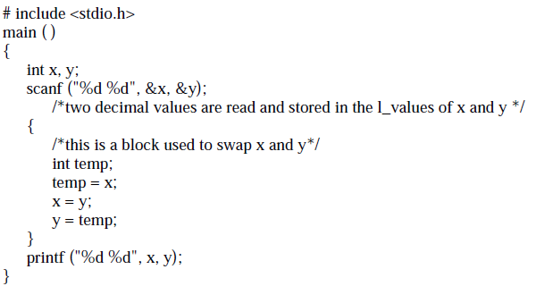

Slide 128
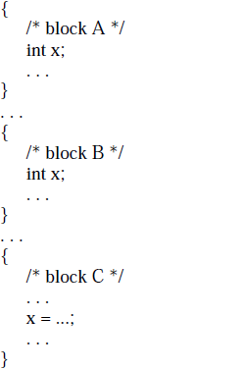

Slide 129
Type:
type of a variable is a specification of the set of values that can be associated with the variable, together with the operations that can be legally used to create, access, and modify such values. A variable of a given type is said to be an instance of the type.
When the language is defined, certain type names are bound to certain classes of values and sets of operations.
For example, type integer and its associated operators are bound to their mathematical counterpart. Values and operations are bound to a certain machine representation when the language is implemented.

Slide 130
In some languages, the programmer can define new types by means of type declarations. For example, in C one can write
typedef int vector [10];
This declaration establishes a binding–at translation time–between the type name vector and its implementation (i.e., an array of 10 integers, each accessible via an index in the subrange 0. .9).
As a consequence of this binding, type vector inherits all the operations of the representation data structure (the array); thus, it is possible to read and modify each component of an object of type vector by indexing within the array.

Slide 131
Traditional languages, such as FORTRAN, COBOL, Pascal, C, C++, Modula-2, and Ada bind variables to their type at compile time, and the binding cannot be changed during execution. This solution is called static typing.
For example, in C one can write:
int x, y; char c;
By declaring variables to belong to a given type, variables are automatically protected from the application of illegal (or nonsensical) operations.
For example, in Ada the compiler can detect the application of the illegal assignment I:= not A, if I is declared to be an integer and A is a boolean. Through this check, the compiler watches for violations to static semantics concerning variables and their types.
The ability to perform checks before the program is executed (static type checking) contributes to early error detection and enhances program reliability

Slide 132
l_value AND r_value
The binding between a variable and the value held in its storage area is usually dynamic;
the value can be modified by an assignment operation. An assignment such as b = a; causes a's r_value to be copied into the storage area referred to by b’s l_value.
That is, b’s r_value changes. This, however, is true only for conventional imperative languages, like FORTRAN, C, Pascal, Ada, and C++.
Functional and logic programming languages treat variables as their mathematical counterpart: they can be bound to a value by the evaluation process, but once the binding is established it cannot be changed during the variable's lifetime.

Slide 133
Routines
Routines is a collection of instruction that can be used to perform specific task and can be repeatedly executed.
Functions and procedure are two forms of routines
Functions returns a value but procedure does not return the value
Functions can be converted to routines by making them void(i.e. returning NULL)
Four attributes name,scope,l-value,r-value
three ways i)declaration ii) call iii) definition
A routine’s l_value is a reference to the memory area which stores the routine body (i.e., the routine’s executable statements). Activation causes execution of the routine body, which constitutes the r_value that is currently bound to the routine

Slide 134
An Abstract Semantic Processor
Language constructs can be executed by sequences of operations of the abstract processor.
an instruction pointer, a memory, and a processor
The memory is where the instructions to be executed and the data to be manipulated are stored
two separate memory sections: the code memory (C) and the data memory (D)
Both C's and D's initial address is 0 (zero), and both programs and data are assumed to be stored from the initial address
The instruction pointer (ip) is always used to point to a location in C; it is initialized to 0.

Slide 135
D[X] and C[X] to denote the values stored in the X-th cell of D and C, respectively.
X is an l_value and D[X] is the corresponding r_value.
Modification of the value stored in a cell is performed by instruction set, with two parameters: the address of the cell whose contents is to be set, and the expression evaluating the new value.
Ex: instruction set 10, D[20] is to assign the value stored at location 20 into location 10
set 15, read means that the value read from the input device is to be stored at location 15

Slide 136
set write, D[50] means that the value stored at location 50 is to be transferred to the output device.
for example, D[15]+D[33]*D[41] would be a an acceptable expression, and
set 99, D[15]+D[33]*D[41] would be an acceptable instruction to modify the contents of location 99
The machine, in fact, operates by executing the following steps repeatedly, until it encounters a special halt instruction:
1. Get the current instruction to be executed (i.e., C[ip]);
2. Increment ip;
3. Execute the current instruction.

Slide 137
unconditional jump to a certain instruction ,jump 47 forces the instruction stored at address 47 of C to be the next instruction to be executed; that is, it sets ip to 47
jumpt 47, D[3] > D[8] the jump occurs only if the value stored in cell 3 is greater than the value stored in cell 8.
allows indirect addressing set D[10], D[20] assigns the value stored at location 20 into the cell whose address is the value stored at location 10.

Slide 138
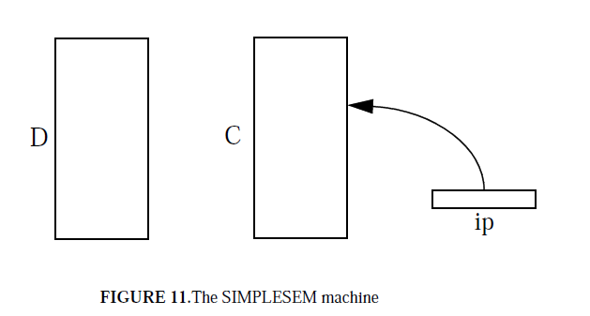

Slide 139
Run Time Structure
Run Time Storage : the compiler demands for block of memory to operating system
Run Time Storage: 1) Code Memory 2) Data Memory
Data Memory keeps a track of procedure activation and store data objects and information
DM 1) Static allocation 2) Stack based allocation 3) Heap.
Static Language: for data object at compile time
Size ,name of data objects bound to storage at compile time only
amount of storage allocated do not change at run time.
Activation record find the addresses of these record. Can fill the addresses at which target code can operate it. FORTAN and COBOL.
Limitation : Recursive procedures are not supported

Slide 140
Run Time Structure
Stack Language: manages the allocation at run time storage
Control Stack
Activation record push the element onto the stack, popped is performed accordingly, dynamically stack allocation is created for data structure.
Limitation: Allocation is slower as compared to static allocation as pointer and index register are required for addressing

Slide 141
Run Time Structure
Heap allocation
Continuous block of memory
Deallocation i.e free space is reused by heap manager
Linked list is used for free allocation

Slide 142
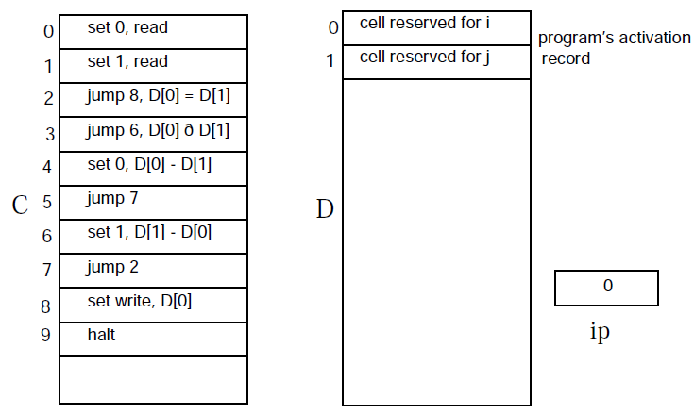
CASE STUDY: Run Time Structure of C
main ( )
{
int i, j;
get (i, j);
while (i != j)
if (i > j)
i -= j;
else
j -= i;
print (i);
}
C1: A language with only simple statements

Slide 144
Introduction
A programming paradigm is a fundamental style of computer programming.
Compare with a software development methodology, which is a style of solving specific software engineering problems.
Different methodologies are more suitable for solving certain kinds of problems or applications domains.
Same for programming languages and paradigms.
Programming paradigms differ in:
the concepts and abstractions used to represent the elements of a program (such as objects, functions, variables, constraints, etc.)
the steps that compose a computation (assignation, evaluation, data flow, control flow, etc.).

Slide 145
Some languages are designed to support one particular paradigm
Smalltalk supports object-oriented programming
Haskell supports functional programming
Other programming languages support multiple paradigms
Object Pascal, C++, C#, Visual Basic, Common Lisp, Scheme, Perl, Python, Ruby, Oz and F#.
The design goal of multi-paradigm languages is to allow programmers to use the best tool for a job, admitting that no one paradigm solves all problems in the easiest or most efficient way.

Slide 146
Introduction to Various Programming Paradigms
To comprehend how languages are constructed, one needs to look deeper.
The four basic computational models that describe most programming today are :
1) Imperative or procedural Language
2) Applicative or functional Language
3) Rule based or logic Language
4) Object oriented Language
5) Abstract level
6) Generic Programming Language

Slide 147
Procedural programming.
Programs are decomposed into computation steps that perform complex operations.
Procedures and functions (collectively called routines) are used as modularization units to define such computation steps.
Functional programming.
functions are the primary building blocks of the program
Abstract data type programming.
recognizes as the unit of program modularity.
Module-based programming.
groupings of entities such as variables, procedures, functions, types, etc.

Slide 148
Object-oriented programming.
definition of classes of objects.
Instances of classes are created by the program as needed during program execution.
Generic programming.
instantiated, either at compile-time or runtime, to create the entities—data structures, functions, and procedures— needed to form the program.
encourages the development of high-level, generic, abstractions as units of modularity.
Declarative programming.
declarative description of a problem, rather than the decomposition of the problem into an algorithmic implementation.

Slide 149
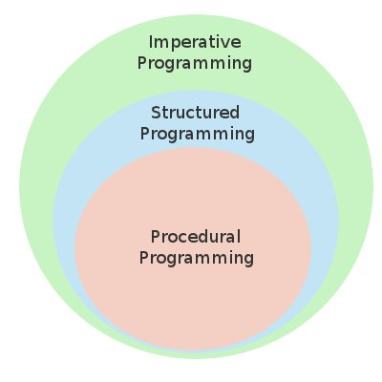
Imperative languages

Slide 150
Procedural programming is a type of imperative programming in which the program is built from one or more procedures (also termed subroutines or functions)
The hardware implementation of almost all computers is imperative. Nearly all computer hardware is designed to execute machine code, which is native to the computer, written in the imperative style.
The main concept in imperative or procedural languages is the machine state. It majorly focuses on which memory location contains which value. These languages are statement oriented or command driven.
On every statement execution, value stored at memory location is changed. This results into change of state. Thus procedural language program contains sequence of statements. General program structure is like :
Statement1;
Statement2;
...

Slide 151
Fig. describes the process .
Memory consists of collection of boxes, the execution of a statement can be represented as accessing the memory location.
Eg: two boxes carry marbles, are added and stored in third box.(in new location).
Program development consist of building the successive machine state needed to arrive to this solution. This is the basic view of programming.
Languages like C,C++,FORTRAN,ALGOL,PL/I, Pascal, Ada , Smalltalk and COBOL supports this model.
2 |  |  | 5
 | 3

Slide 152
Applicative or functional Language
In this model program development is the process of development of functions from previously developed functions which can be used for developing more complex functions. These functions, then, can manipulate the initial set of data until the final function can be used to compute an answer from the initial data.
Once the final answer is obtained, we apply that to the initial data and arrive at a result. Such languages have following general syntax:
Function,, ( ... f unction2 (function1 (data)) ... )
e.g. LISP and ML are two functional languages .

Slide 153
Rule based languages
Rule based languages checks for the existence of a certain enabling condition. If such conditions are present, they execute an appropriate action.
Prolog is the most common rule based language. Since basic enabling conditions are certain classes of predicate logic expressions, it is also called as logic programming language.
In rule based language execution is similar to an imperative language except that order of execution of statements is not sequential but depends on enabling conditions.
The syntax of such languages generally is similar to the following :
enabling condition1→ action1,
enabling condition2 → action2,
……………….
enabling condition n→ action n
e.g. Apart from Prolog, the most common language in this class, many other languages use this paradigm. The common business application of decision tables is a form of rule based programming.

Slide 154
Object-oriented programming
In OO-Programming model, focus is on data. So complex data objects are created and then to manipulate those objects some functions are built.
To built the complex objects, simpler objects are built first and then extended to complex objects by using the properties of simpler objects.
Building of Separate functions, which use a restricted data provides reliability to the application being developed.
Languages coming under object oriented paradigm are characterized by following features :
(1) Abstract data type
(2) Inheritance and
(3) A particular kind of dynamic binding.

